Slide 2


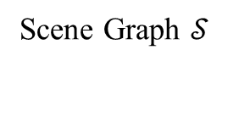
Atomic Action Pattern | Generation Logic
Move to a named surface | If the object can fit on the surface.
Move to a location around a specific object | If there exists a place to fit this object, which only involves receptacle regions of one specific object.
Move to a location with specific direction relative to a specific object | If there exists a place to fit this object, which only involves receptacle regions of specific direction relative to the specific object.
Move to a location between two objects | If there exists a place to fit this object, and the covered receptacle regions correspond to complementary directional pairs(e.g. left and right, front-left and rear-right) from two different objects.
Atomic action Patterns 𝒜
Scene Graph $𝒮$

Slide 3
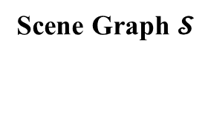
Atomic Actions | Generation Logic
Move to a surface | If the object can fit on the surface.
… | …
Integrate
Atomic action Patterns 𝒜
Scene Graph $𝓢$
Process-based Tasks

Slide 4

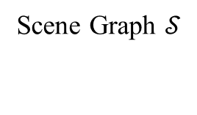
Pattern 12: Align all [SUB-PLATFORM-OBJECTS00] on [PLATFORM0] symmetrically
Atomic action Patterns 𝒜
Process-based Tasks
Scene Graph $𝒮$

Slide 5




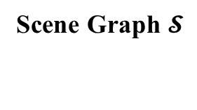
Pattern 12: Align all [SUB-PLATFORM-OBJECTS00] on [PLATFORM0] symmetrically
Template-based Generation
Scene Graph $𝓢$
3 VLM
Raw Tasks
Voting
Outcome-based Tasks

Slide 6



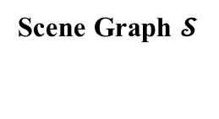
Pattern 12: Align all [SUB-PLATFORM-OBJECTS00] on [PLATFORM0] symmetrically
VLMs
Scene Graph $𝓢$
Outcome-based Tasks
Raw Tasks

Slide 7

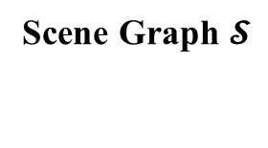
Atomic Action Pattern | Generation Logic
Move to a named surface | If the object can fit on the surface.
Move to a location around a specific object | If there exists a place to fit this object, which only involves receptacle regions of one specific object.
Move to a location with specific direction relative to a specific object | If there exists a place to fit this object, which only involves receptacle regions of specific direction relative to the specific object.
Move to a location between two objects | If there exists a place to fit this object, and the covered receptacle regions correspond to complementary directional pairs(e.g. left and right, front-left and rear-right) from two different objects.
Atomic action 𝒜
Process-based Tasks
Scene Graph $𝓢$

